Slide 1

Lecture-3
Geographical Background

Slide 2
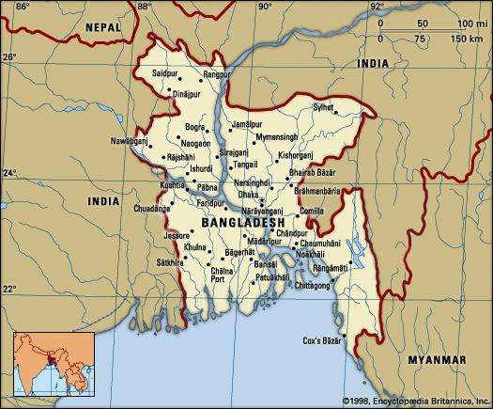
Bangladesh is a small country situated at the north-eastern part of South Asia. It lays between 20⁰34′ and 26⁰38′ north latitudes and between 88⁰01′ and 92⁰41′ east longitudes.
It is bounded on the West by West Bengal, on the north by West Bengal and Meghalaya, on the East by Assam, Tripura and Myanmar and on the South by Bay of Bengal.

Slide 3
Geographical Location of Bangladesh
Bangladesh is a densely-populated, low-lying, mainly riverine country located in South Asia with a coastline of 580 km (360 mi) on the northern part of the Bay of Bengal. The delta plain of the Ganges (Padma), Brahmaputra (Jamuna), and Meghna Rivers and their tributaries occupy 79 percent of the country.
The cultural history of Bangladesh has evolved from the operation of several forces and elements. Of those the basic force is perhaps geography. Hence for a proper understanding of the cultural history of Bangladesh it is necessary to have a glimpse of geographical and environmental aspects.

Slide 4
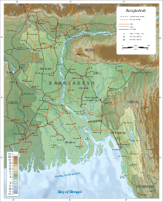
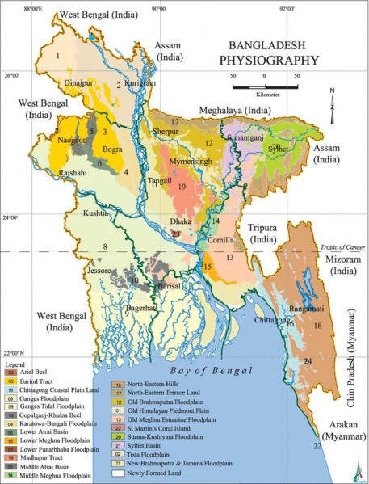
Map of Bangladesh
Coastline, roads, railroads, and place names are based on a 1996 CIA map

Slide 5
Area and boundaries
Area: total: 148,460 km² country comparison to the world: 95 land: 130,170 km² water: 18290 km²
Land boundaries: total: 4,413 km border countries: Myanmar 271 km, India 4,142 km
Coastline: 580 km
Land use: Arable land: 73% Permanent crops: 2% Permanent pastures: 5% Forests and woodland: 15% other: 5% (1993 est.)

Slide 6
What is Physiography
Physiography is the holistic discussion of the earth and its characteristics.
Physiography is the terrain condition of a tract of land.
It reveals the condition of the surface of land. It deals about the total feature of the crust.
The physiography may vary from place to place.

Slide 7
Physiographic features of Bangladesh
Bangladesh is a low lying and vast plenty area. Its physiographic feature is much diversified. It is mentionable here that the physiographic feature of an area may change in pace of time due to natural and artificial cause.
Physiographic Classification
1.Tertiary Hills
2. Pleistocene Hills
3. Flood Plains

Slide 8
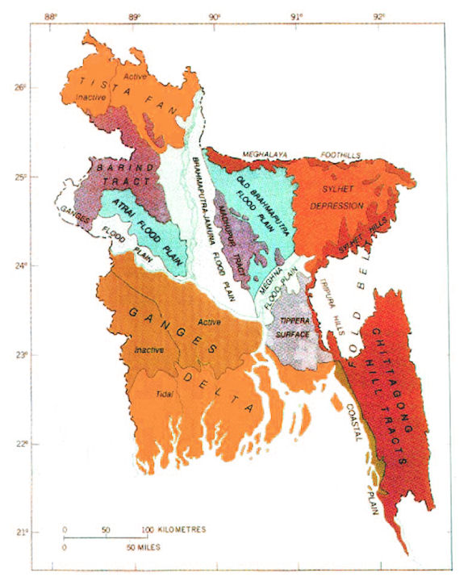
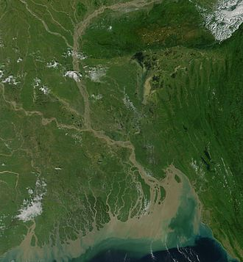
Physiographic features of Bangladesh
NASA satellite Image of Bangladesh

Slide 9
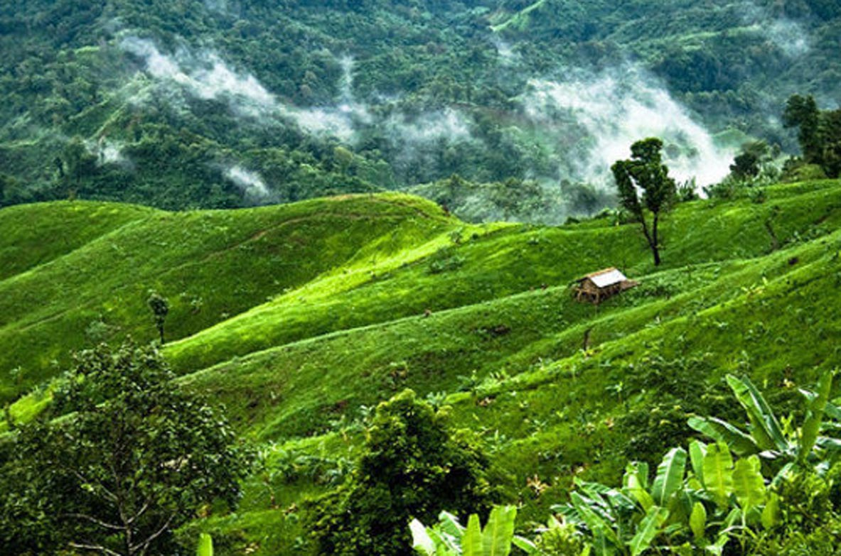
1. Tertiary Hills
developed in Tertiary period (35-15 m yrs ago) occupying 12% of the land area
located mainly in the southeastern regions of Ctg & CHTs and northern part of great Sylhet District.
topography is largely determined by geological structure (folded, faulted & uplifted) & rock type (sandstone, siltstone & shale of mid-Tertiary age).
It is subdivided into three parts-
1.1 Chittagong and Hill Tract Districts
1.2 Hill ranges of northeastern Sylhet District
1.3 Hills along the narrow frontier strip of Sylhet and Mymensingh District.

Slide 10
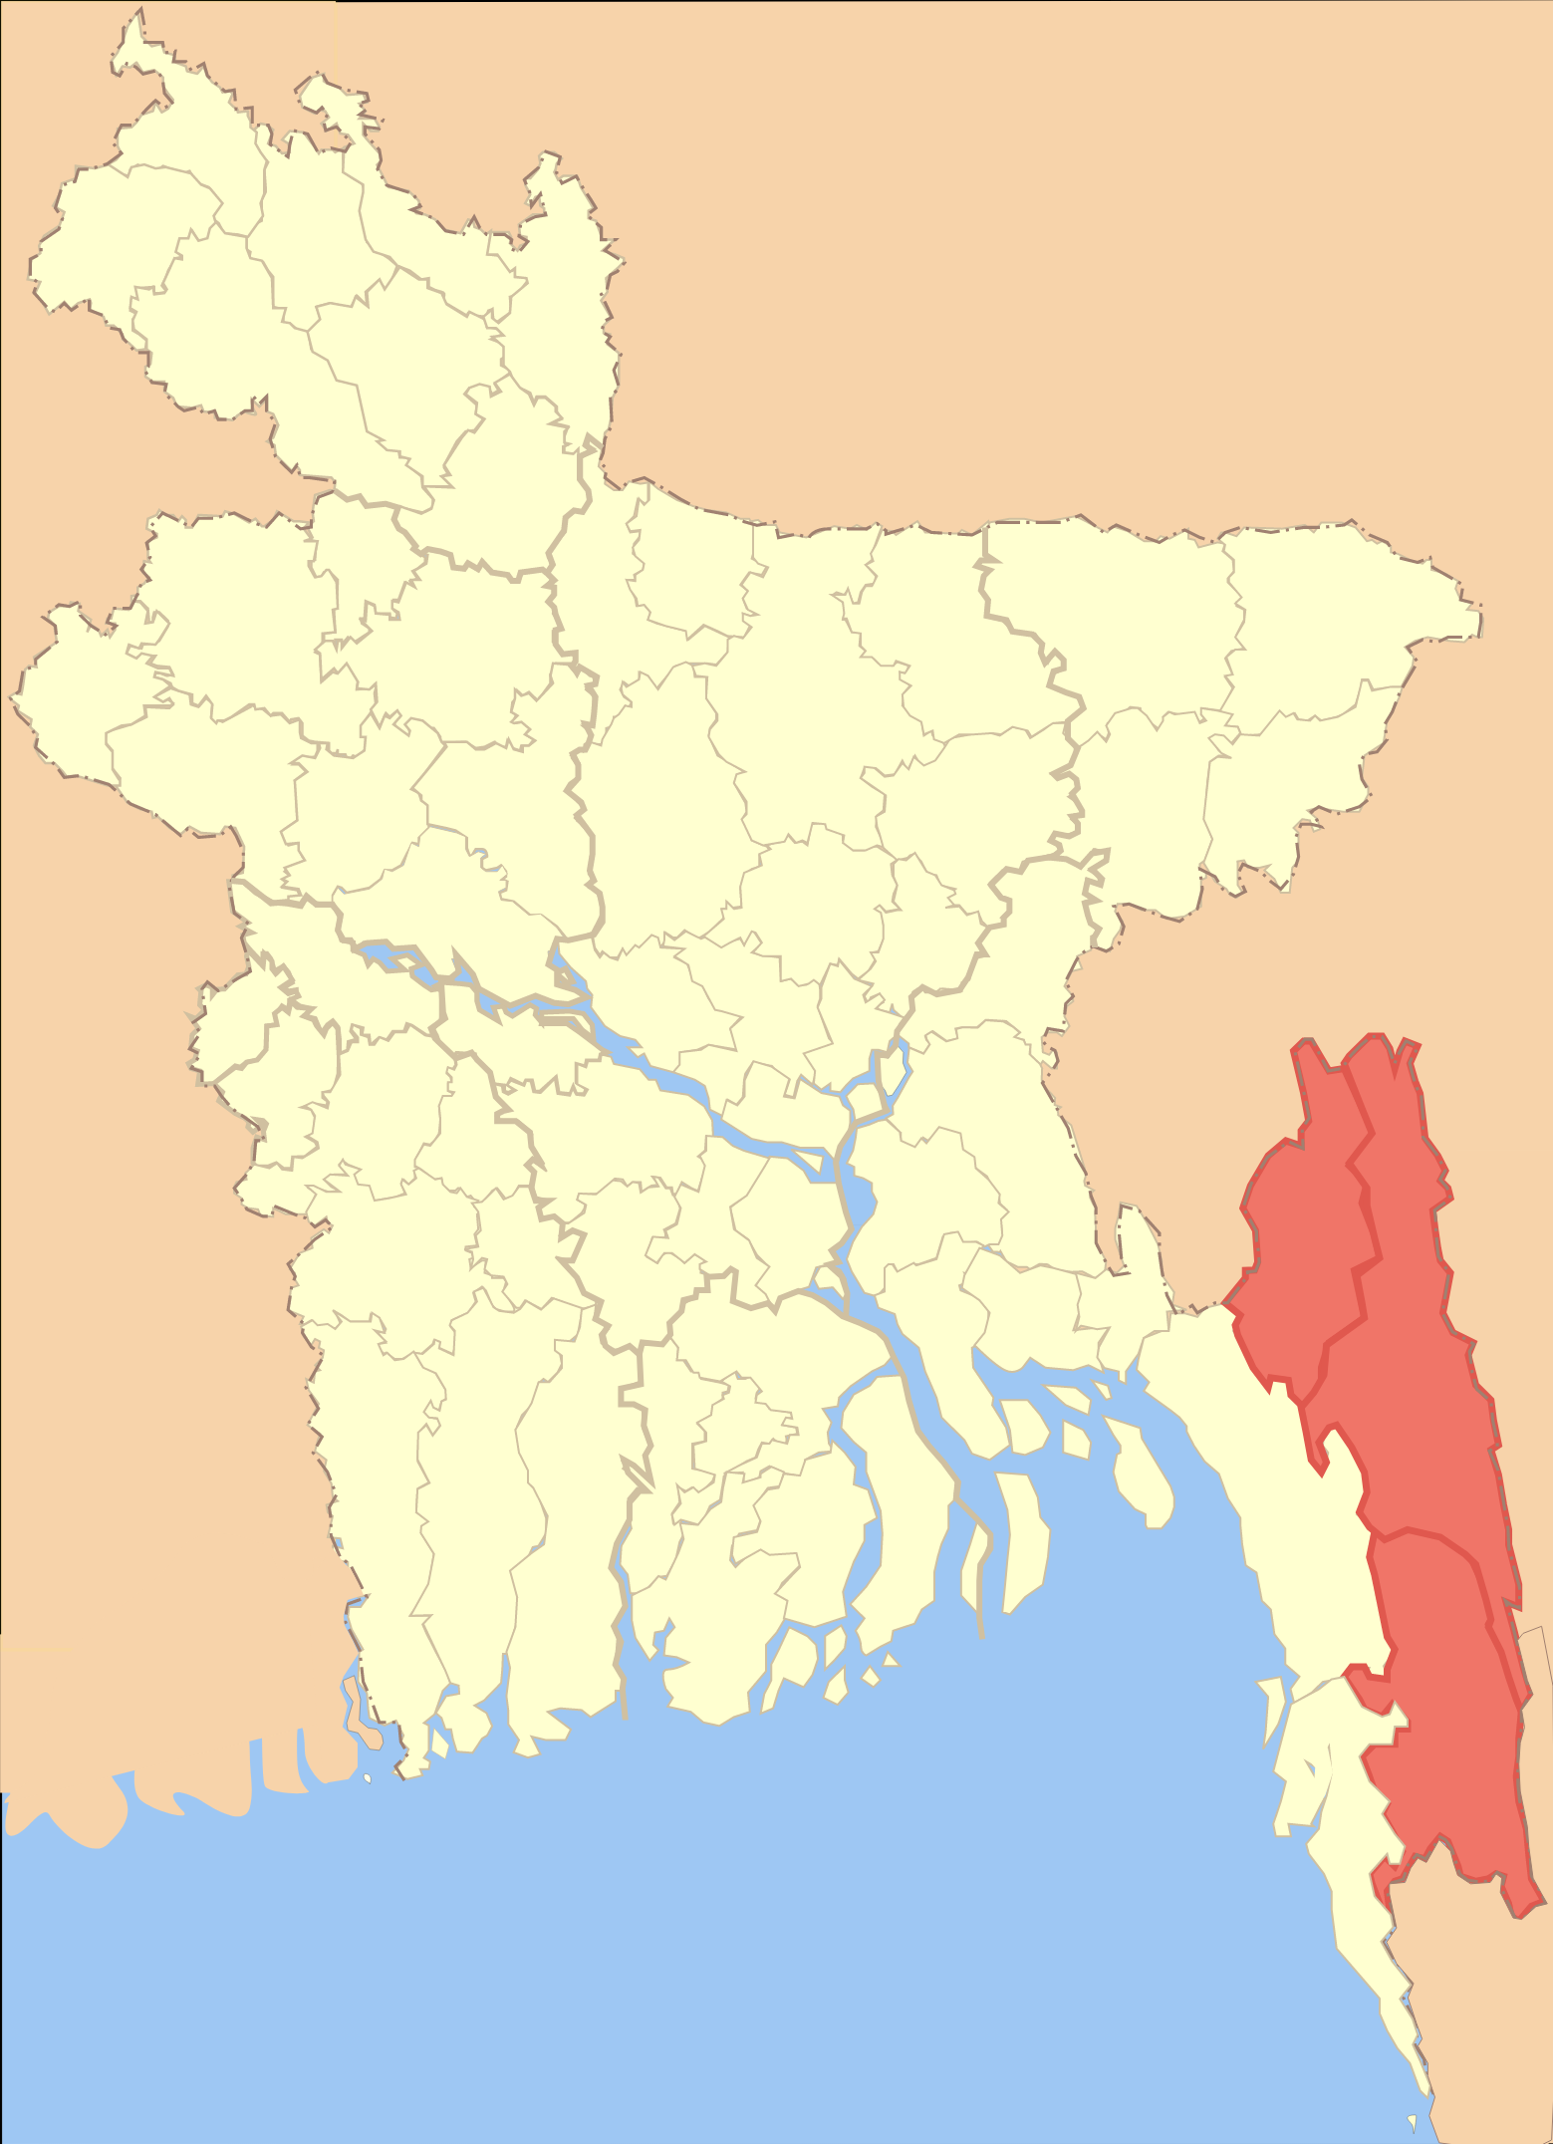
1.1 Chittagong hill tracks
High north-south striking hill ranges occupy wholly the districts of Chottogram, Cox’s Bazar and the hill track districts. The hills becomes higher towards east reaching a maximum height of 1000m.
The lowest ranges generally follow the eastern coast of the Bay of Bengal from Feni river to Naf river and continue southwards across the Mayanmar border. Most of the Moheskhali Island belongs to this hilly region. There is a narrow strip of coastal plain in the Chottogram District and a very narrow strip of beach from Cox’s Bazar to Teknaf, between the hills and the Bay of Bengal. Chokoria Sundarban and the associated Mud flat area is a small delta of the Matamuhuri river.
Towards the east, the ranges get higher and the slop steeper until they reach the highest hill range in the east that marks the boundary between Bangladesh, Mayanmar and India.

Slide 11
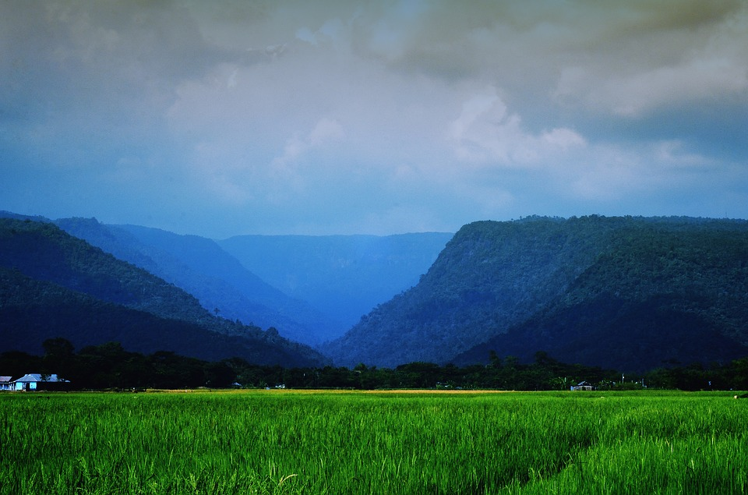
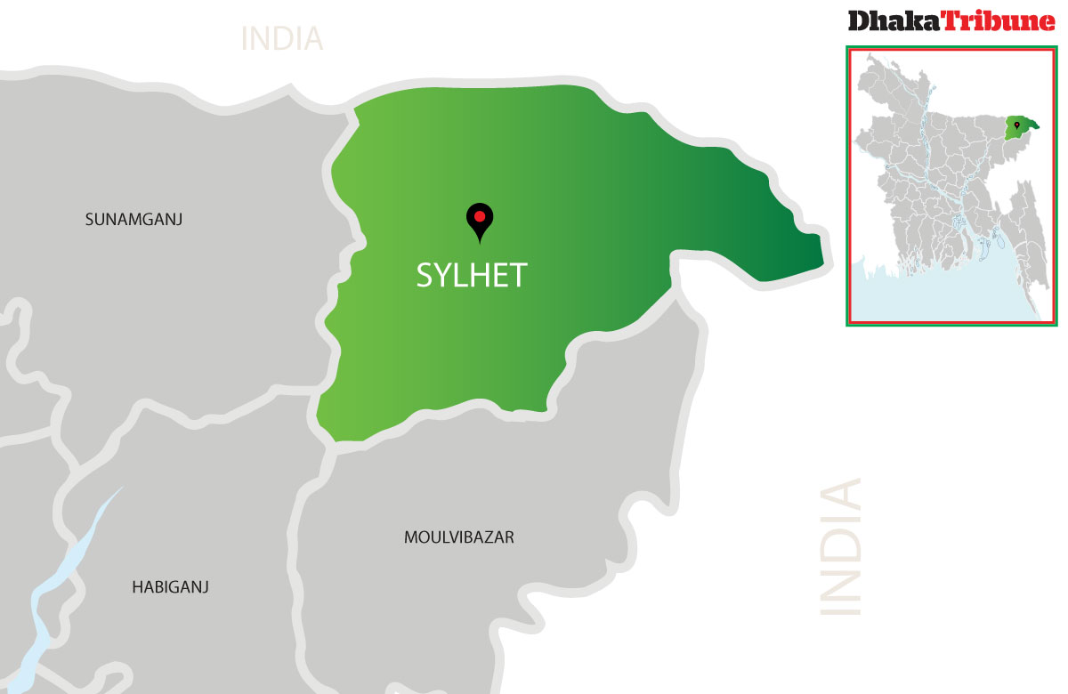
1.2 Hill ranges of Northern Sylhet: Some of the hill ranges of the Chittagong and the Hill Tract districts continue northward across the Indian State of Tripura and from the hill ranges of northeastern Sylhet region. These hill ranges attain a much lower elevation and slope more gently than their continuation in the Chittagong and the Hill Tract districts.

Slide 12
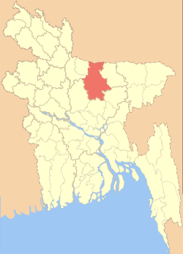
1.3 Hills along the Narrow strip of Sylhet and Mymensing Districts The narrow strip of disconnections low hill ranges extends from Jaflong in he east to Bramaputra river in the west. These hills do not form continuous range but constitute a chain of circular and elongated hillocks separated by Holocene alluvial valleys. Along the frontier of greater Mymensing these hills from series of circular and elongated hillocks.

Slide 13
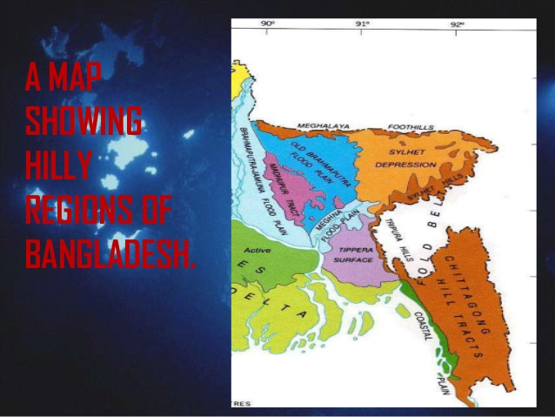

Slide 14
2. The Pleistocene Terrace or The Pleistocene Uplands
2.1. The Barind Tract
The Barind Tract is located in the west of the Brahmaputra River. It covers an area of 7680 sq. km in the Rajshahi division.
The Barind Tract is the product of vertical movements of Pleistocene period and reaches as maximum height of 20 m above modern flood plains.
2.2 The Madhupur Tract
This area of about 4,058 sq. km. extends in Dhaka, Mymensingh and Tangail districts.
In the Madhupur Tract, reddish brown clay deposits are exposed on some north south trending elongated flat landmass abruptly elevated from the surrounding floodplains.
In Madhupur Tract the landmass reaches a maximum height of 17 m from sea level.

Slide 15
2.3. Lalmai Hills
The Lalmai Hills are situated in the Comilla district and are composed of reddish brown clay.
The Lalmai Hills represent a north-south elongated low hill range of about 16 km long and about 2-3 km wide. It covers an area of about 33 sq. km.. The average height is about 12 m
The reddish brown deposits exposed in the Lalmai Hills area is considered as the extension of the reddish brown deposits of the Madhupur area of Pleistocene age.

Slide 16
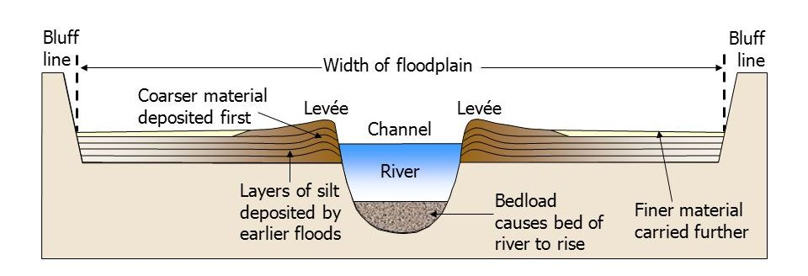
3. Flood plains
Flood plains are also known as alluvial plains through fluvio-deltaic processes.
flood plains are created due to the deposition (alluvium) of the GBM rivers covering 80% of the land in Bangladesh. It is a plain land which stretches from the Himalayas to the Bay of Bengal. The most significant features of the land is the large network of rivers, big and small khals, lakes(bills), swamps and marshes. Many rivers flow across the plain towards the south. The three main ones are the Padma( ganges),The Jamuna(Brahmaputra) and the Meghna.

Slide 17
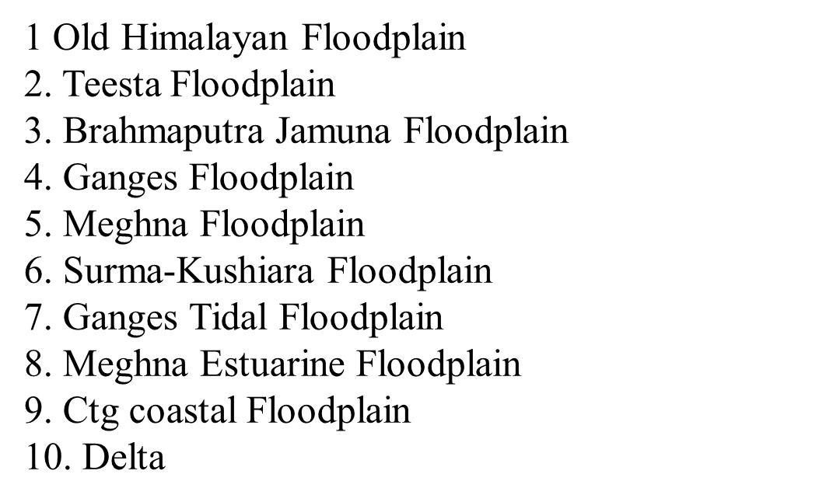
there are as many as 10 types of flood plains in BD, of which the Ganges plains cover a major part.

Slide 18
Old Himalayan Piedmont Plain
Old Himalayan Piedmont Plain (4,008 sq km) this distinctive region is developed in an old Tista alluvial fan extending from the foot of the himalayas. It has a complex relief pattern. Deep, rapidly permeable sandy loams and sandy clay loams are predominant in this region. They are strongly acidic in topsoil and moderately acidic in subsoils; low in weatherable K minerals. Seven general soil types occur in the region, of which non-calcareous brown floodplain soils, black terai soils, and non-calcareous dark grey floodplain soils predominate. Organic matter contents are generally higher than in most floodplain soils of Bangladesh. The natural fertility of the soil is moderate but well sustained. Soil fertility problems include rapid leaching of N, K, S, Ca, Mg and B. Most of panchagarh and thakurgaon districts and the northwestern part of dinajpur district are included in this zone.

Slide 19
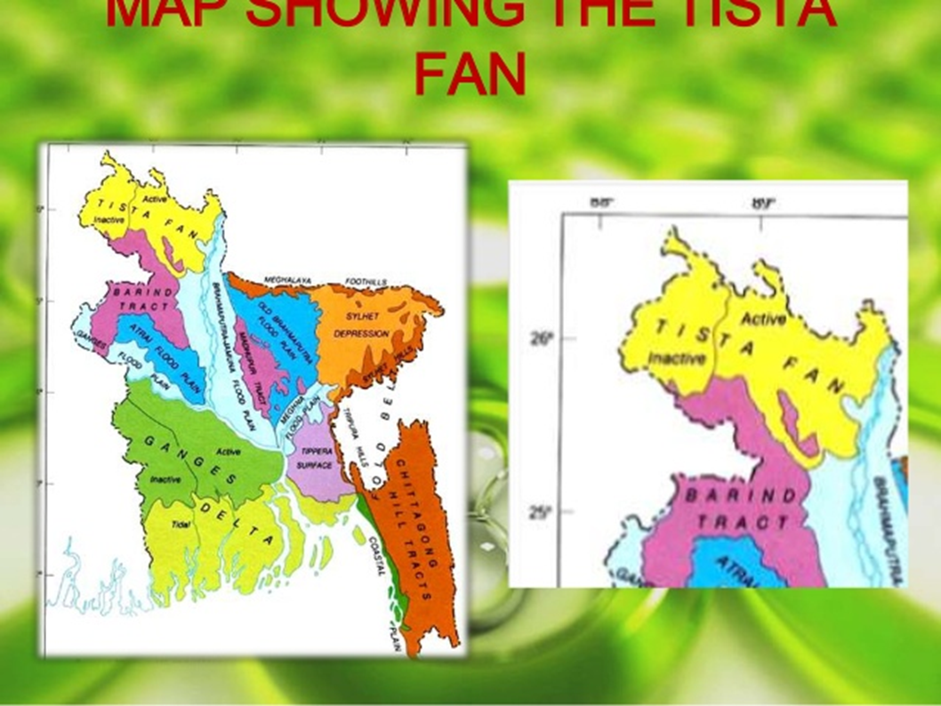
Teesta Fan
The Teesta fan is at the northwestern part of Bangladesh. It is the extension of the Himalayan piedmont plain that slope southward from a height of 96 m to 33m with a gradient of about 55cm/km. The region is covered by the piedmont sand and gravel, which were deposited as alluvial fan of the Teesta, Mahananda and Karatoya rivers and their distributaries issuing from the Terai area of the foothills of Himalayas. There was a major shift in the courses of these rivers in 1887.

Slide 20
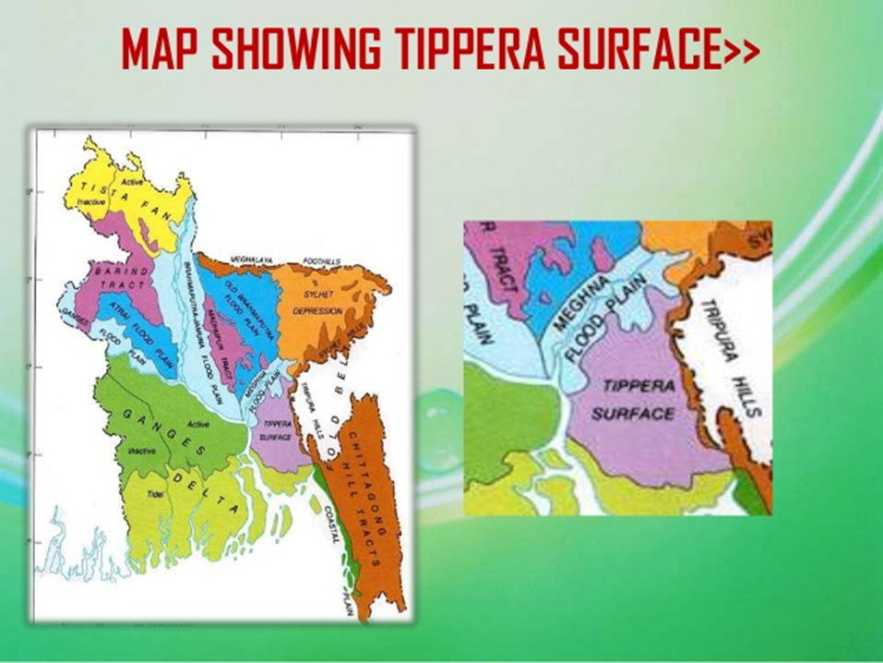
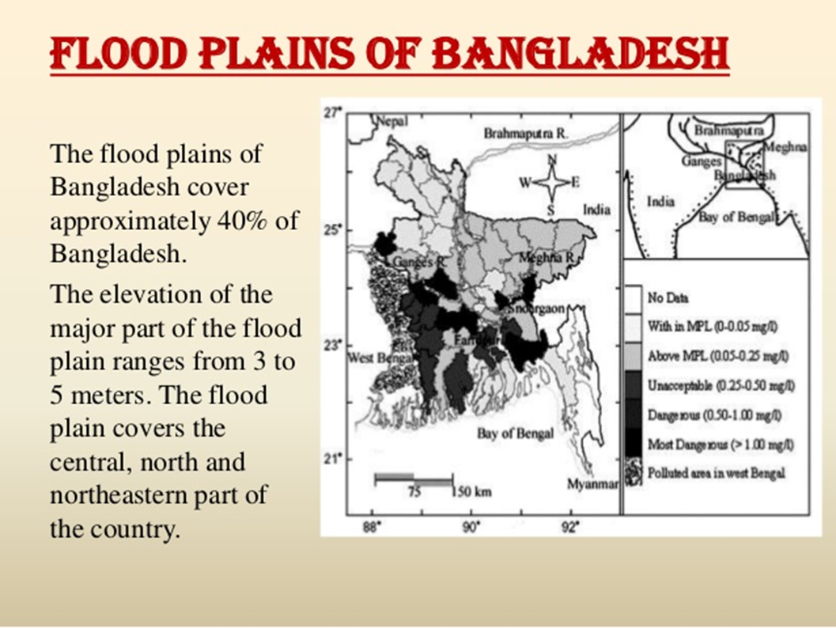

Slide 21
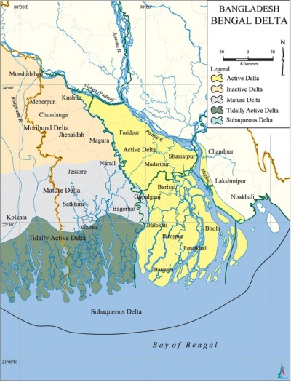
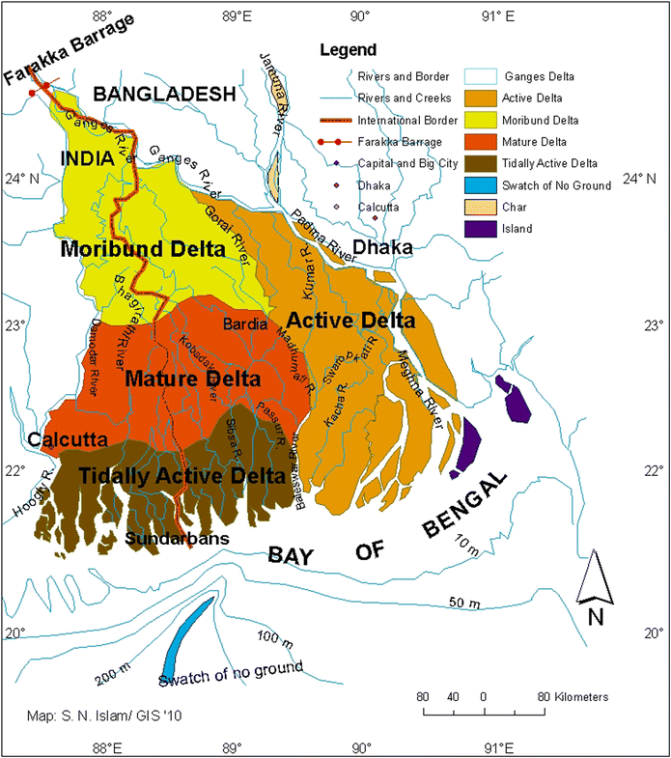
The present Delta is a combination of three deltas, namely the
1. Ganges delta 2. The old Brahmaputra-Meghna delta 3. The Ganges-Jamuna ( the present Brahmaputra)-Meghna delta

Slide 22
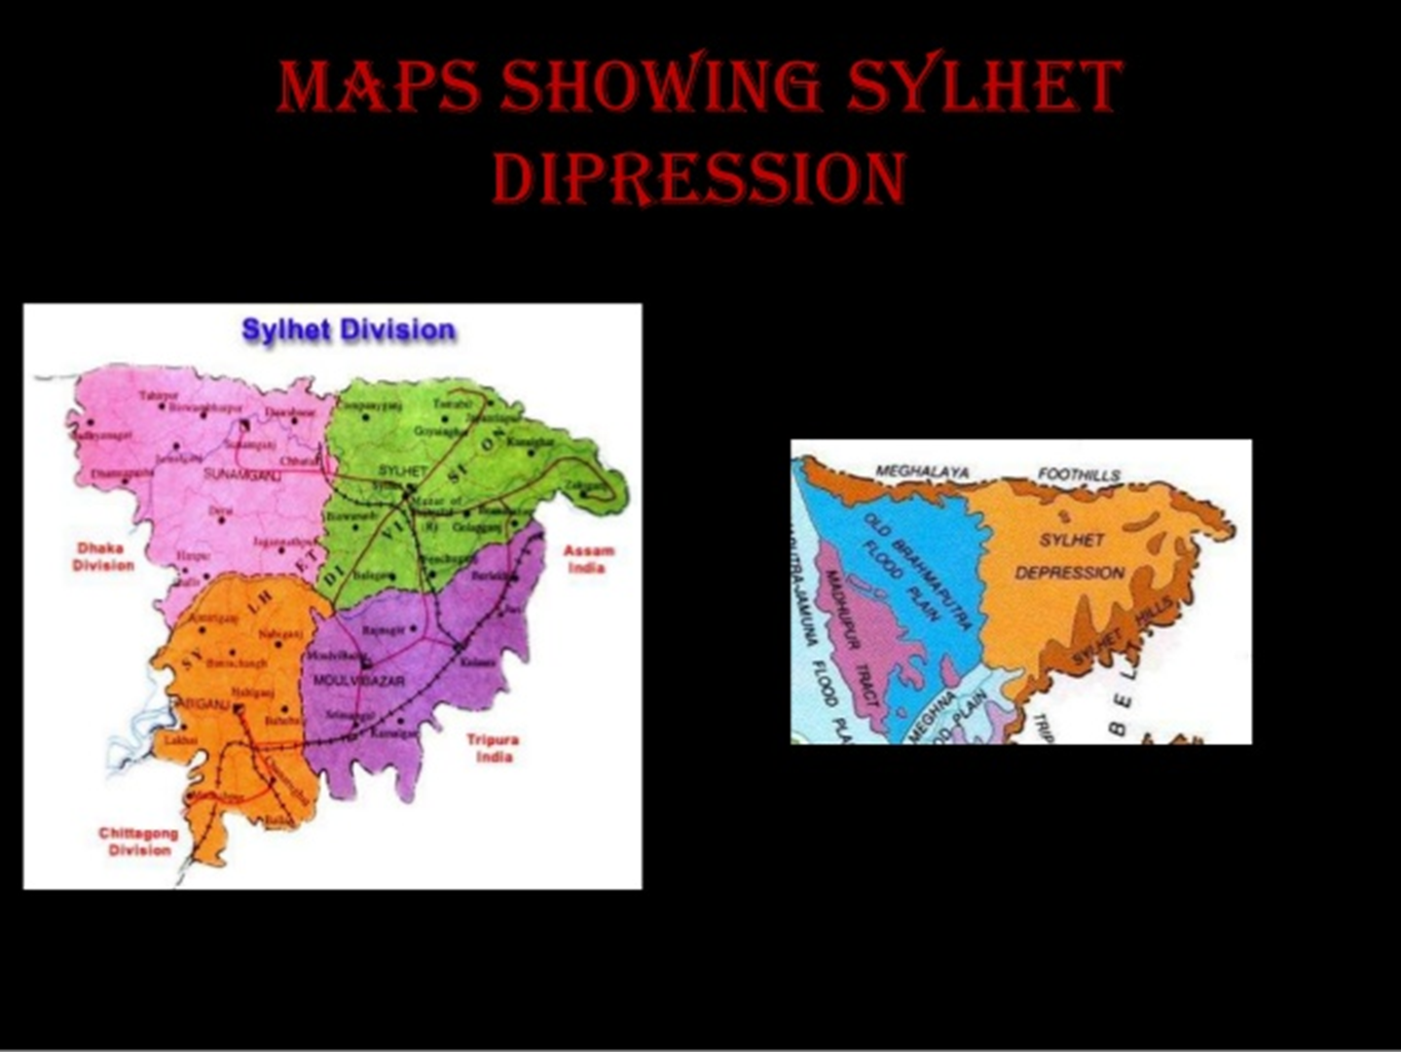
Sylhet depression
Sylhet depression or Basin (4,573 sq km) the region occupies the lower, western side of the Surma-Kushiyara floodplain. Relief is locally irregular near rivers. Soils of the area are grey silty clay loams and clay loam on the higher parts that dry out seasonally and grey clays in the wet basins. The soils have a moderate content of organic matter and soil reaction is mainly acidic. Fertility level is medium to high.

